Slide 1
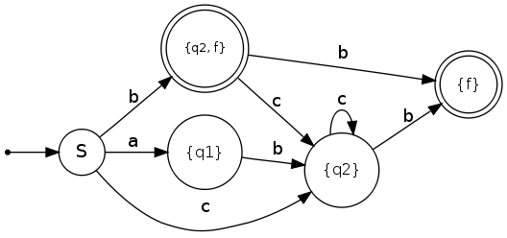
19CSE214-Theory of Computation
Course Overview
CREDITS TO Ms.Prathilothamai
Department of Computer Science and Engineering,
Amrita School of Engineering, Amrita Vishwa Vidyapeetham, Coimbatore.

Slide 2
Course Objectives & Outcomes
Objectives
Introduce concepts in automata theory and theory of computation
Identify different formal language classes and their relationships
Design grammars and recognizers for different formal languages
Design automata and recognizers for different formal languages
Understand the concept of undecidability
Outcomes
COs | Course Outcome | Bloom’s Taxonomy Level | Course Plan
15CSE303.CO 1 | Design and develop of various Finite state machines | L3 | Course Plan
15CSE303.CO 2 | Demonstrate the pushdown automata model for a given language | L3
15CSE303.CO 3 | Understand and design the various types of Turing machine | L3
15CSE303.CO 4 | Analyse the properties of different languages | L3
15CSE303.CO 5 | Understand the concepts of undecidability | L1

Slide 3
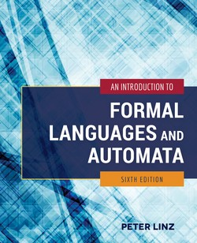
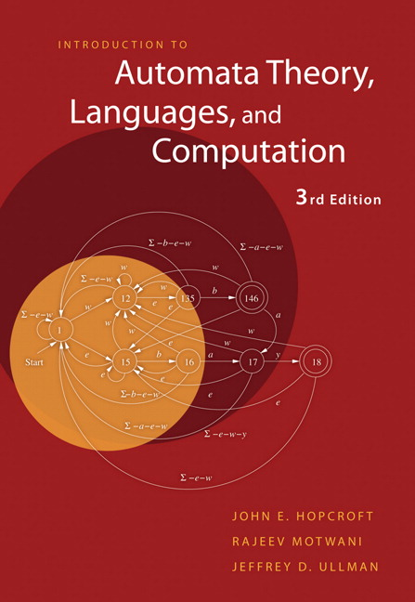
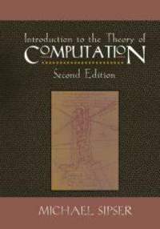
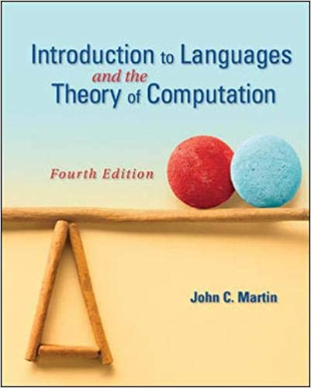
Text / Reference Books
Linz P. An introduction to formal languages and automata. Sixth edition, Jones and Bartlett Publishers; 2016(Text Book)
Hopcroft JE, Motwani R, Ullman JD. Introduction to Automata Theory, Languages and Computation. Third Edition, Pearson; 2006.
Sipser M. Introduction to the Theory of Computation. Third Edition Cengage Publishers; 2005.
Martin JC. Introduction to Languages and the Theory of Computation. Fourth Edition McGraw-Hill; 2010.

Slide 4
Course Pre-Requisites & Organization
Pre-Requisites
Data Structure and Algorithms
Discrete Mathematics
Course Organization
Generally, the course will contain three parts:
Part I) Finite Automata and Regular languages (21 Hours)
Part II) Pushdown automata and Context-free languages (15 Hours)
Part III) Context-sensitive languages & Turing machines & decidability. (9 Hours)

Slide 5
Course Assessment Details
S.No | Name of the Assessment | Nos. | Max. Marks | Weightage % | Mode
1 | Case Study (Group) | 1 | 20 | 8 | Teams
2 | Tutorial & Quizzes | 2 & 3 | 15 | 12 | AUMS
3 | Periodical I-online | 1 | 25 | 5 | AUMS
 | Periodical I-Viva | 1 | 10 | 10 | Teams
4 | Periodical II-online | 1 | 25 | 5 | AUMS
 | Periodical II-viva | 1 | 10 | 10 | Teams
5 | EndSem-online quiz | 1 | 40 | 20 | AUMS
6 | Viva | 1 | 30 | 30 | Teams
 | Total | 100
Total |  |  |  | 100

Slide 6
Faculty Team
S.No | Name of the Faculty | Section | Mail Id
1 | Ms. P.Malathi | A | P_malathy@cb.amrita.edu
2 | Ms.M.Prathilothamai | B | m_prathilothamai@cb.amrita.edu
3 | Ms.G.R.Ramya | C | gr_ramya@cb.amrita.edu
4 | Dr. T Gireesh Kumar | D | t_gireeshkumar@cb.amrita.edu
5 | Dr. C Shunmuga Velayutham | E | cs_velayutham@cb.amrita.edu
6 | Ms.T.Bagyammal | F | t_bagyammal@cb.amrita.edu
Mentor: Ms. M. Prathilothamai

Slide 7
Why Theory of Computation (TOC) is Important?
To understand the nature of efficient computation.
In theoretical Computer Science and Mathematics, the TOC is the branch that deals with how efficiently problems can be solved on a model of computation, using an algorithm.
To understand and design a Compiler in better manner.
Student will be able to answer all questions of important exams like GATE, ISRO, DRDO etc.

Slide 8
TOC: Practical Applications
Circuit Design and Verification
Finite Automata
Natural Language Processing
Linguistics (Modelling by grammar)
Game Development
Finite Automata as strategy models in decision making

Slide 9
TOC: Practical Applications
Finite Automata (FA)
For the designing of lexical analysis of a compiler.
For recognizing the pattern using regular expressions.
For the designing of the combination and sequential circuits using Mealy and Moore Machines.
Used in text editors.
For the implementation of spell checkers.
Push Down Automata (PDA)
For designing the parsing phase of a compiler (Syntax Analysis).
For implementation of stack applications.
Evaluating the arithmetic expressions.
Solving the Tower of Hanoi Problem.

Slide 10
TOC: Practical Applications
Linear Bounded Automata (LBA)
For implementation of genetic programming.
For constructing syntactic parse trees for semantic analysis of the compiler.
Turing Machine (TM)
For solving any recursively enumerable problem.
For understanding complexity theory.

Slide 11
Interesting Applications & Tools
Interesting Applications
Finite State Machines – Traffic Light Simulation
https://youtu.be/jLLAtxPNaC0
Finite State Machines in Embedded Programming
https://youtu.be/0Fqa5RFZ29E
Finite State Machines in games: AI
https://youtu.be/ayssrKvqJ4g
The AI of Half-Life: Finite State Machines
https://youtu.be/JyF0oyarz4U
Tools
Regex to NFA to DFA
https://cyberzhg.github.io/toolbox/nfa2dfa
Regex to NFA
http://ivanzuzak.info/noam/webapps/fsm2regex/

